Slide 1
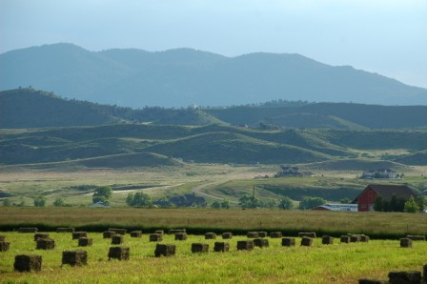
FEDERAL LANDS
Phase 1: Mountain Communities (2017)
Phase 2: Front Range Communities (2018)
LARIMER COUNTY: FRONT RANGE COMMUNITIES
PHASE 2 OF A NEW COMPREHENSIVE PLAN
Notes:
Matt to introduce

Slide 2
ONLINE VISIONING SURVEY
How can the County better
prepare for the future?
20 out of 22 issues were voted “Very Important” or “Important” by respondents

Slide 4
OPPORTUNITY AREAS

Slide 5
OPPORTUNITY AREAS

Slide 6
OPPORTUNITY AREAS

Slide 7
OPPORTUNITY AREAS

Slide 8
OPPORTUNITY AREAS

Slide 9
OPPORTUNITY AREAS
Notes:
Unincorporated Larimer population in 2016 was 31,509. Not all of the population lives within platted subdivisions; account for majority of future increase.
In Larimer County subdivisions, there are a total of 3,858 unbuilt residential entitlements, with 361 falling within GMAs and 3,497 outside. With an average household size of 2.49 (U.S. Census Quickfacts), these parcels will accommodate an estimated population increase of 899 people within GMAs and 8,708 outside.

Slide 10
OPPORTUNITY AREAS
+3,497
unbuilt parcels outside GMAs
= 8,708 population
+361 within GMAs
=899
population
Notes:
In Larimer County subdivisions, there are a total of 3,858 unbuilt residential entitlements, with 361 falling within GMAs and 3,497 outside. With an average household size of 2.49 (U.S. Census Quickfacts), these parcels will accommodate an estimated population increase of 899 people and 8,708 outside.
The higher median home prices outside of GMA ($307,033) than market supports ($256,680 within urban areas) and lack of housing diversity contributes to a slower absorption outside of GMA.
Because of the oversupply of the same housing type, there is an opportunity to revise suite of subdivision types to diversify and meet market demands.

Slide 11
OPPORTUNITY AREAS

Slide 12
OPPORTUNITY AREAS

